Slide 1
Angular 2
Angular 2 is a leading framework for building
heavy Javascript website.
A faster, more powerful, cleaner, and easier to use tool than we had with Angular 1.​

Slide 2
Building Block
Architecture
1. Component
2. Modules
2. Directives
3. Routers
4. Services

Slide 3
Component {}
Every Angular2 App has atleast one component that is root component.
A component encapsulate the template, data and behaviour of a view.
Each component has a template or HTML markup view as well as data and logic behind the view.
Component can have another component inside
a compoent.

Slide 4
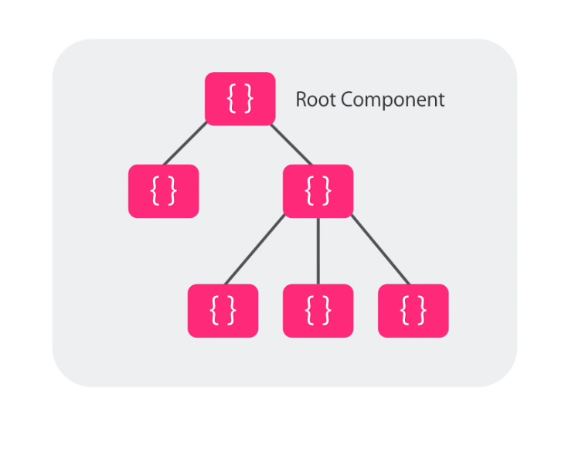

Slide 5


Slide 6
A component is nothing but a plain Typescript class.
export class HeroDetailComponent {
hero: Hero;
setRating(value){
....
}
}

Slide 7
How do angular know that this class is an component?
IT looks for specific attribute or metadata in classes.
To make this AppComponent class a component we need to apply a component decorator to this class

Slide 8
Decorator
The @Component decorator provides the Angular metadata for the component.
import { Component } from '@angular/core' ;
@Component({
selector: 'hero-detail',
template: `<h1>helo angular</h1>`
styleUrls: ['home.component.css']
})

Slide 9
Decorator
@Component({
selector: 'hero-detail',
template: `<h1>helo angular</h1>`
styleUrls: ['home.component.css']
})
export class HeroDetailComponent {
hero: Hero;
}

Slide 10
2. Modules
Angular apps are modular and Angular has its own modularity system called Angular modules or NgModules.
Every Angular app has at least one Angular module class, the root module.
While the root module may be the only module in a small application, most apps have many more feature modules.
@NgModule //decorator

Slide 11
3.Directives
Angular templates are dynamic. When Angular renders them, it transforms the DOM according to the instructions given by directives
Structural Directives
Structural directives alter layout by adding, removing, and replacing elements in DOM.
*ngFor, *ngIf
Attribute Directives:
Attribute directives alter the appearance or behavior of an
existing element.
ngModel, hidden, required

Slide 12
4.Routes
Routing is another name for navigation. The router is the mechanism for navigating from view to view.
The Angular router is an external, optional Angular NgModule called RouterModule that presents a particular component view for a given URL..
The router is a combination of multiple provided services (RouterModule), multiple directives (RouterOutlet, RouterLink, RouterLinkActive), and a configuration (Routes). You'll configure the routes first.

Slide 13
Routing
Either I can use template selectors directly in template tag embeded in app.component.ts like
@Component({
selector: 'my-app',
template: `<knol-header></knol-header><knol-home></knol-home>`
})

Slide 14
Or I can use Routing which I should use
For routing we use <router-outlet> tag like below
@Component({
selector: 'my-app',
template: `<router-outlet></router-outlet>`
})

